Slide 1
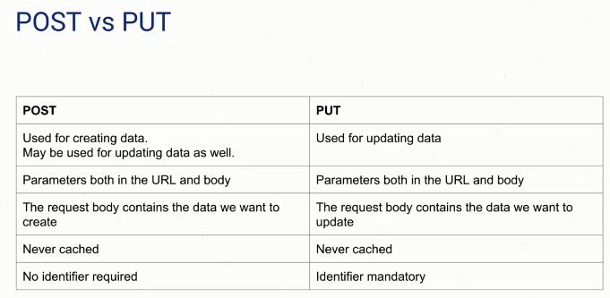
POST Vs. PUT

